Slide 1
Economic Conditions in the Region
Jason Bram, Research Officer
Westchester County Association Regional Workforce Development Summit
January 16, 2020
The views expressed here are those of the presenter and do not necessarily represent those of the Federal Reserve Bank of New York or the Federal Reserve System.

Slide 2
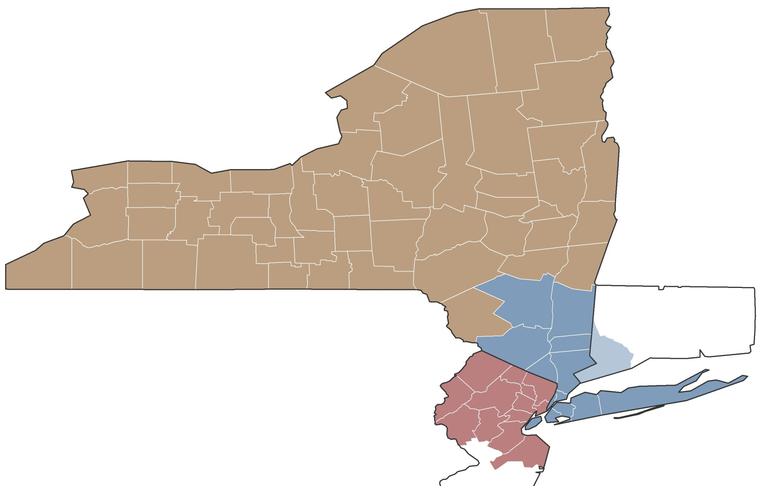
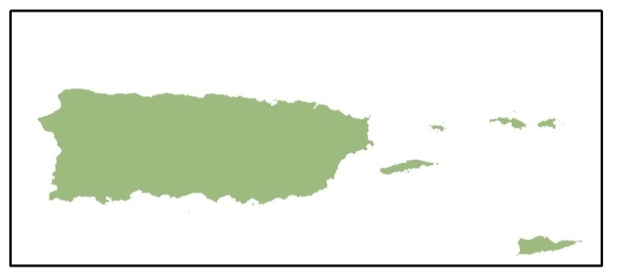
The 2nd Federal Reserve District
Regions in the District
Upstate NY
Puerto Rico &
Northern NJ
Fairfield
U.S. Virgin Islands
Downstate NY
FEDERAL RESERVE BANK OF NEW YORK
1

Slide 3
Preview
Unemployment rates are at or near record lows.
NYC remains the engine of job growth in the region.
There are signs that the economy is slowing.
Businesses are having trouble finding workers.
Wage growth has remained subdued.
FEDERAL RESERVE BANK OF NEW YORK
2

Slide 4
Unemployment Rates
Seasonally Adjusted
Percent
12
10
New York City
New Jersey
8
6
United States
4
Nov
New York State
Dec
2
0
Shading indicates NBER recession
1990 1994 1998 2002
Source: Bureau of Labor Statistics and Moody's Economy.com.
2006
2010
2014
2018 2022
3

Slide 5
Difficult to Find Workers in the Region
Long-Run and Current Unemployment Rates, Seasonally Adjusted
10%
Long-Run Average (1990 to 2015 Average)
Current (Nov 2019)
8%
New York City
7.8
Northern New Jersey
United
States
6%
Hudson
Valley
6.1
6.1
Dutchess County
Westchester County
Orange County
Fairfield
Rockland County
5.1
5.1
Putnam County
5.2
5.0
4.9
4.8
4%
4.5
4.0
3.7
3.7
3.9
3.5
3.5
3.7
3.5
3.6
3.2
2%
0%
Source: U.S. Bureau of Labor Statistics and Moody’s Economy.com.
4

Slide 6
Regional Employment Trends
Total Employment, Seasonally Adjusted Index
Index (Dec2007=100)
125
Nov
120
115
New York City
110
United States
Dec
105
Orange-Rockland-
Westchester
100
Fairfield
Kingston
95
90
2007
Shading indicates NBER recession
2009
2011
2013
2015
2017
2019
2021
Source: Bureau of Labor Statistics and Moody's Economy.com; data are early benchmarked by FRBNY staff.
5

Slide 7
Regional Employment Trends
Private-Sector Employment, Seasonally Adjusted Index
Index (Dec2007=100)
120
115
Orange
Rockland
110
United States
105
Westchester
100
Putnam
Dutchess
95
90
2006
2007
2008
2009
2010
2011
2012
2013
2014
2015
2016
2017
2018
2019
Source: U.S. Bureau of Labor Statistics (QCEW) and Moody’s Economy.com
6

Slide 8
Job Growth Has Slowed in and Around NYC
Annual Percent Change in Total Employment
3%
NYC
2%
U.S.
2.2%
Hudson
Valley
Northern NJ
1.5%
Long Island
1%
0.6%
Fairfield County CT
0%
-0.2%
Previous Five Years Change (Nov13-Nov18) (Annualized)
-0.5%
-0.5%
Past Year Change (Nov18-Nov19)
-1%
Source: U.S. Bureau of Labor Statistics and Moody’s Economy.com; data are early benchmarked by New York Fed staff.
7

Slide 9
Home Prices Softening in NYC Area, Up in Mid-Hudson Valley
Annual Percent Change in Home Prices
8%
Nearby Counties
Queens
Kings
Richmond
6%
Bronx
Dutchess
U.S.
Orange
Putnam
5.5%
4.5%
4.7%
4.9%
4%
3.7%
3.4%
Rockland
Manhattan
Bergen
2%
Westchester
Fairfield
1.5%
0.8%
0.8%
0.8%
0.1%
0%
-1.7%
-2%
Previous Five Years Change (Nov13-Nov18 Annualized)
Past Year Change (Nov18-Nov19)
-4%
-4.0%
Source: CoreLogic Home Price Index.
8

Slide 10
Sources: NY State Department of Labor, QCEW; FRBNY staff calculations
9

Slide 11
NYC Securities Employment
Seasonally Adjusted Levels
290
Thousands
Thousands
4,700
Shading indicates time
between securities
peak and trough
230
4,150
Securities
Employment
Total Employment
(left axis)
Minus Securities
(right axis)
Nov
170
3,600
110
3,050
50
2,500
1965
1970 1975
1980
1985
1990
1995 2000
2005
2010
2015 2020
2025
Source: Bureau of Labor Statistics, Moody's Economy.com, and FRBNY calculations.
10

Slide 12
New York City’s New Growth Sector
Number of Jobs in Thousands
200
Thousands
150
NYC Securities Employment
+19,000
Jan10 to Jun19
+86,000
100
NYC Tech Employment
Technology Employment
Computer manufacturing
Electronic shopping
Software publishing
Data processing, hosting
Internet/web search portals
Internet publishing
Computer systems design
Scientific R&D services
50
0
Shading indicates NBER recession
1990
1992
1994
1996
1998
2000
2002
2004
2006
2008
2010
2012
2014
2016
2018
2020
Source: U.S. Bureau of Labor Statistics (QCEW) and Moody’s Economy.com.
11
Notes:
Nov 17 2019
S 5.49 9.08
P 0.39 1.57

Slide 13
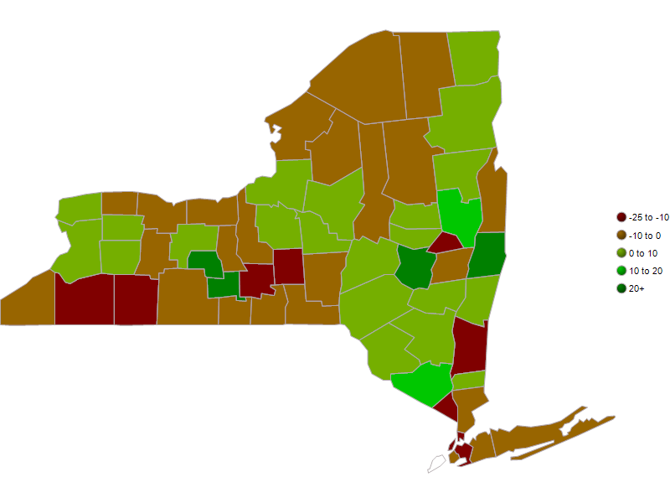
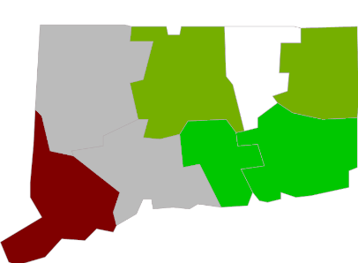
Manufacturing Job Growth by County
5 Years (2014 Q1 - 2019 Q1)
Source: U.S. Bureau of Labor Statistics (QCEW) and Moody’s Economy.com.
12

Slide 14
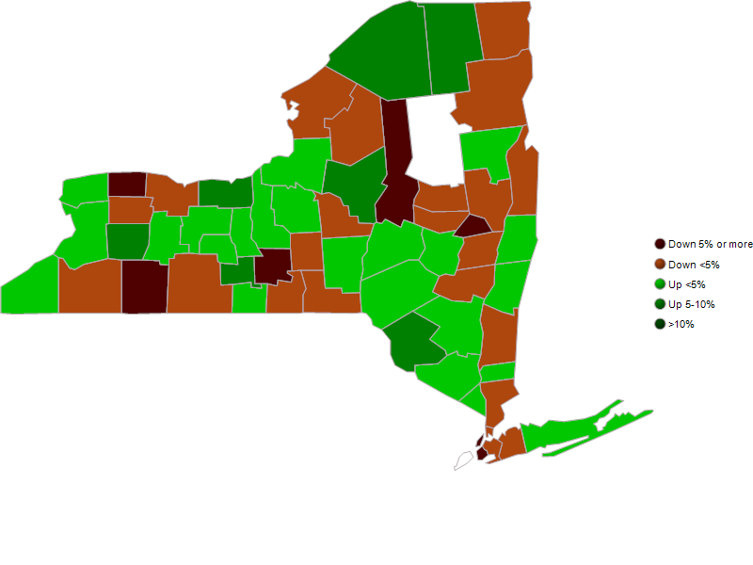
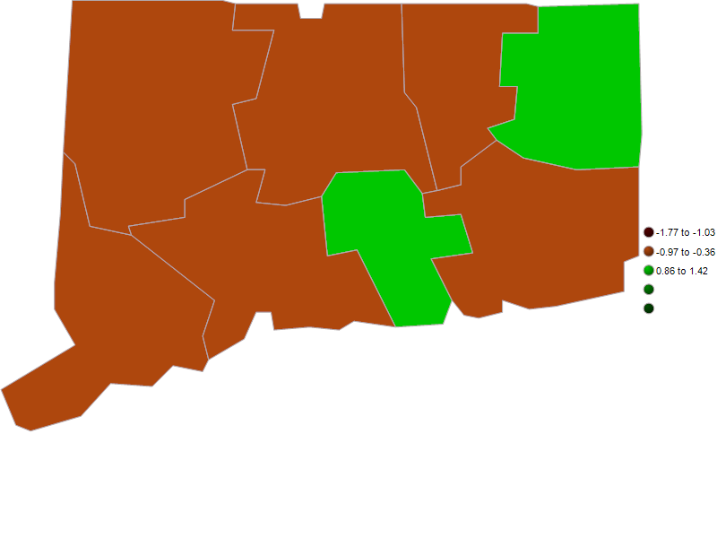
Manufacturing Job Growth by County
Past Year (2018 Q2 - 2019 Q2)
Source: U.S. Bureau of Labor Statistics (QCEW) and Moody’s Economy.com.
13

Slide 15
Surveys Point to Hiring Difficulties
New York Fed Regional Business Surveys
80%
Have you had difficulty hiring workers in the last three months because of lack of qualified candidates?
65
67
60%
65
56
49
40%
45
20%
0%
Nov 2017
Nov 2018
Nov 2019
Nov 2017
Nov 2018
Nov 2019
Business Leaders Surveys
Empire State Manufacturing Surveys
Source: Federal Reserve Bank of New York, Regional Business Surveys, Supplemental Questions.
14

Slide 16
Survey Conducted in …
Source: Federal Reserve Bank of New York, Regional Business Surveys, Supplemental Questions.
15

Slide 17
Survey Conducted in …
Source: Federal Reserve Bank of New York, Regional Business Surveys, Supplemental Questions.
16

Slide 18
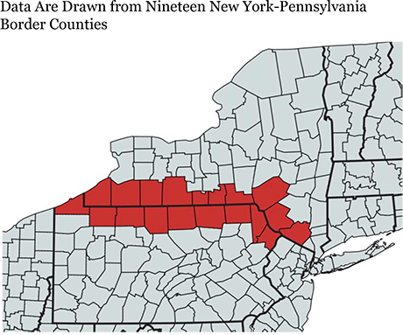
Employment Effects of Minimum Wage
Analysis of Counties Along Both Sides of the NY/PA Border
Taken from Liberty Street Economics blog post: https://libertystreeteconomics.newyorkfed.org/2019/09/minimum-wage-impacts-along-the-new-york-pennsylvania-border.html
17

Slide 19
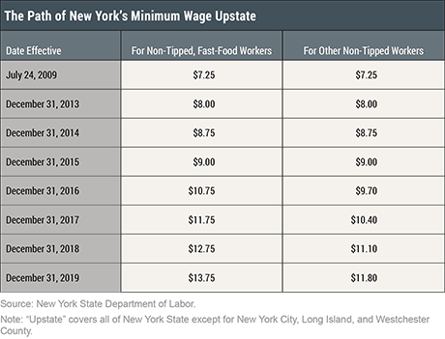
Results of Our Analysis of the NY/PA Border
Since the fourth quarter of 2009, workers in both New York and Pennsylvania have been subject to the federal minimum wage of $7.25 per hour.
Over the past 6 years, upstate New York’s minimum wage has gone up; as of 2019 it stood at $11.10 (50% higher than in PA) and $12.75 for non-tipped, fast-food workers.
18

Slide 20
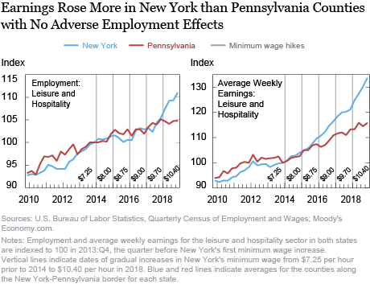
19

Slide 21
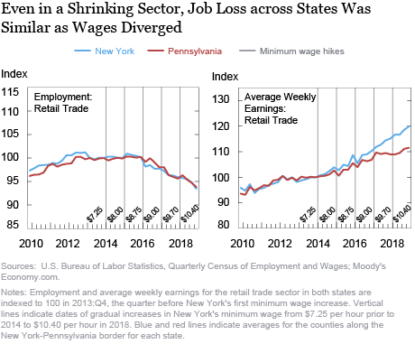
20

Slide 22
Recap
Unemployment is near record lows across the region.
NYC remains the engine of job growth in the region.
There are signs that the economy is slowing.
Job growth has slowed.
Recent business surveys are giving less positive signals.
Housing markets have softened.
Businesses are having trouble finding workers.
Despite tight job markets, wage growth remains subdued.
FEDERAL RESERVE BANK OF NEW YORK
21

